Slide 1
CONTINUITY ENGINE
Solution Overview
Notes:
Move end-user slide up
growth of neverfail slide for brian

Slide 2
Global Presence
20+ Years of Successful Delivery
4000+ Customers in 40 Countries
Year over Year Growth 7 Years Running
95%+ Customer Satisfaction Rating
Who is
Neverfail?
Notes:
Value proposition: Near Zero User Downtime
Ensures core business services are always-on
Unmatched technology
Unique combination of application-focused monitoring, automation and replication that ensures business continuity of mission-critical processes
Strong market presence
4K+ customers across 40 countries, Validation via industry leading OEM partners

Slide 3
A Long History of Global Success
Southern Software

Slide 4
EVOLUTION OF BUSINESS CONTINUITY
Availability
Centric
Continuous Availability
Business
Focus
No User or Application Downtime, Application-Awareness, Automation, Local & Remote Availability
Basic Failover
Hardware Focus
Clustering, Fault Tolerance, Virtual Availability
Data Replication
Snapshot, Asynchronous, Synchronous, CDP
Data
Focus
Recovery
Centric
Backup & Restore
File, Block, Full, Incremental, On-Site, Off-site

Slide 5
THE AVAILABILITY ECOSYSTEM
User/Customer
Applications
Hardware
Network
Data
Operating System
Cybersecurity
Notes:
So, obviously application awareness is critical to providing continuous availability, but applications do not run in a silo.
To compound the problem, most companies know they are dependent on technology, but very few know the actual impact of downtime to their business. So, they start with defining a recovery time objective, or how long they can be down before the business impact is too great. They evaluate solutions based on their ability to meet that recovery time objective, but forget that the failover is the shortest part of any outage. You first have to find out there is a problem (which is usually complaints once the users can’t work), then determine the cause, then determine whether to try and fix it or failover. They also forget that you have to look at all of the components that go into effectively failing over and providing continuity in unplanned scenarios as well – The ecosystem
Starts with data, but the data has to have available hardware and line up with the OS to make sure it can mount without corruption or be accessed at all
There has to be network connectivity to get to the hardware and access the data
Applications have to be available and in sync with the data
Most importantly users have to be able to access the application to turn the data into information, otherwise, it is not usable
Again, the problem is most of the market only provides protection against hardware and network issues. You can get replication to protect the data, you can cluster or use virtualization tools to address the hardware and resource issues. But, if you do believe Gartner and the analysts, 80% of outages occur at the application and user level.
If you only protect 1 or 2 components of the ecosystem you are guaranteeing yourself of 2 things:
You increase the risk of being able to recover at all
You absolutely increase the time it will take to recover, even when you can
For core business applications, that is not acceptable. If you are going to invest in continuity, you need a solution that will protect the entire ecosystem, so you can ensure your recovery objectives are always met, in every scenario. You also need a solution that can monitor against all types of outages, fix issues as they occur, and provide seamless failover and failback so you are protected against the full outage. That summarizes the unique value proposition that only Neverfail can provide.

Slide 6
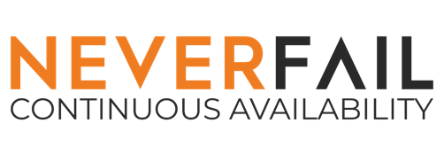
PROACTIVE, INTELLIGENT CONTINUOUS APPLICATION AVAILABILITY
Cloned Server Architecture
Continuous Replication
Continuous Monitoring
Zero Distance Limitations
Flexible Deployment Options
Patch Management Ready
Users Keep Working

Slide 7
CONTINUITY ENGINE
Comprehensive BC/DR
WANSmart™
WANSmart™
Local Area Network
LAN
LAN
LAN
LAN
Intelligent Proactive Protection
Application Aware
Hardware & Storage Agnostic
Physical, Virtual, or Both
Failover & Back in Minutes
Keep Users Connected
Multi-Site Disaster Recovery
Zero Geographical Limitations
No Impact to Failover Time
No Impact to User Experience
Up to 30x Less Bandwidth Required
Protect VMs or Application Chains
Tertiary Business Continuity
Local HA AND Offsite DR
Flexible Maintenance Enablement
Protect n-Tier business process with consistent RTO/RPO
Easy Stair Step to Cloud

Slide 8
NEVERFAIL FAILOVER ENGINE TECHNICAL ARCHITECTURE
Primary
Secondary
Apps
Apps
Neverfail
Channel
LAN or WAN
Step 4
The Application Management Framework (AMF) will monitor the health of the server, network, application, and available resources via a set of threshold rules and provides recovery actions that proactively responds to failure events.
Step #3
The Neverfail Channel connects and it begins a Full System Check (FSC) that synchronizes delta changes of the protected dataset between the primary and secondary server.
Failover
In the event of a failure event, Continuity Engine will detect failure of the application and can automatically failover the application to the secondary server.
Switchback
Once the data has been completely resynchronized, Continuity Engine will perform a switchback, returning the application to the operating state it was in prior to the failure.
Step #1
Install Continuity Engine from the Engine Management server, onto the Primary server.
Engine Management Service
Step #2
Once Continuity Engine is deployed, the cluster is extended by cloning the primary server to create the secondary server.

Slide 9
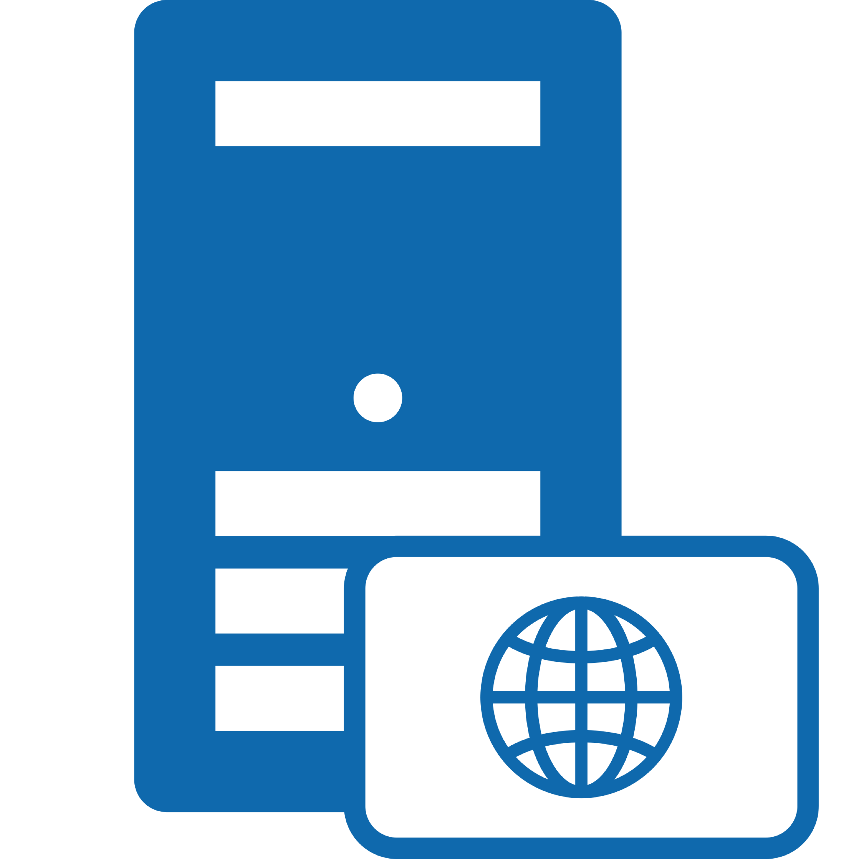
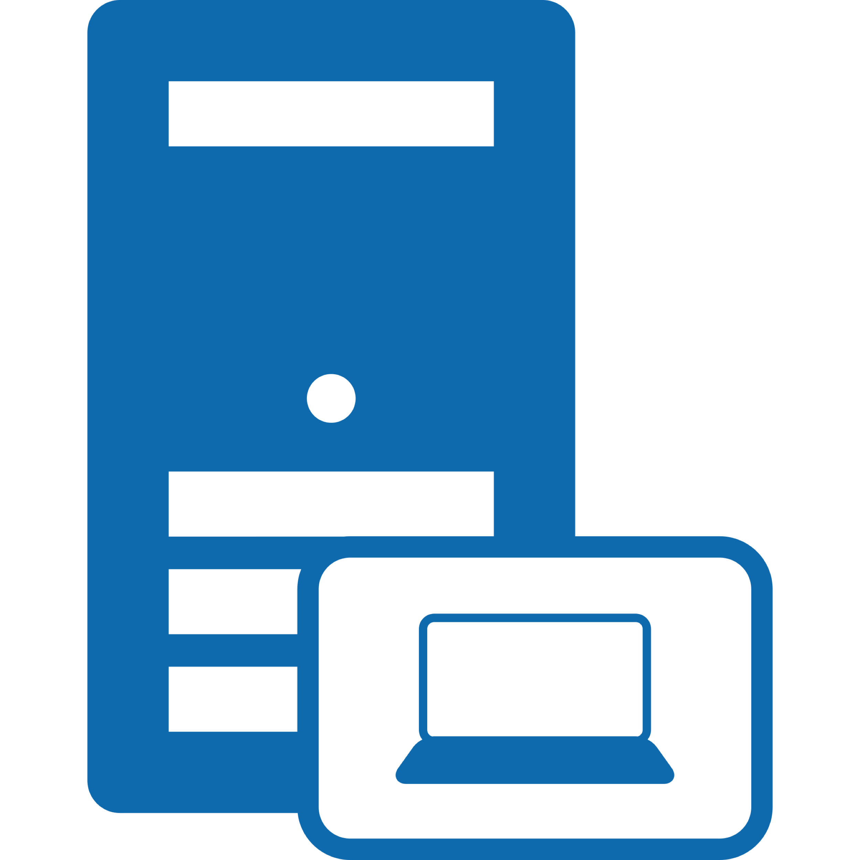
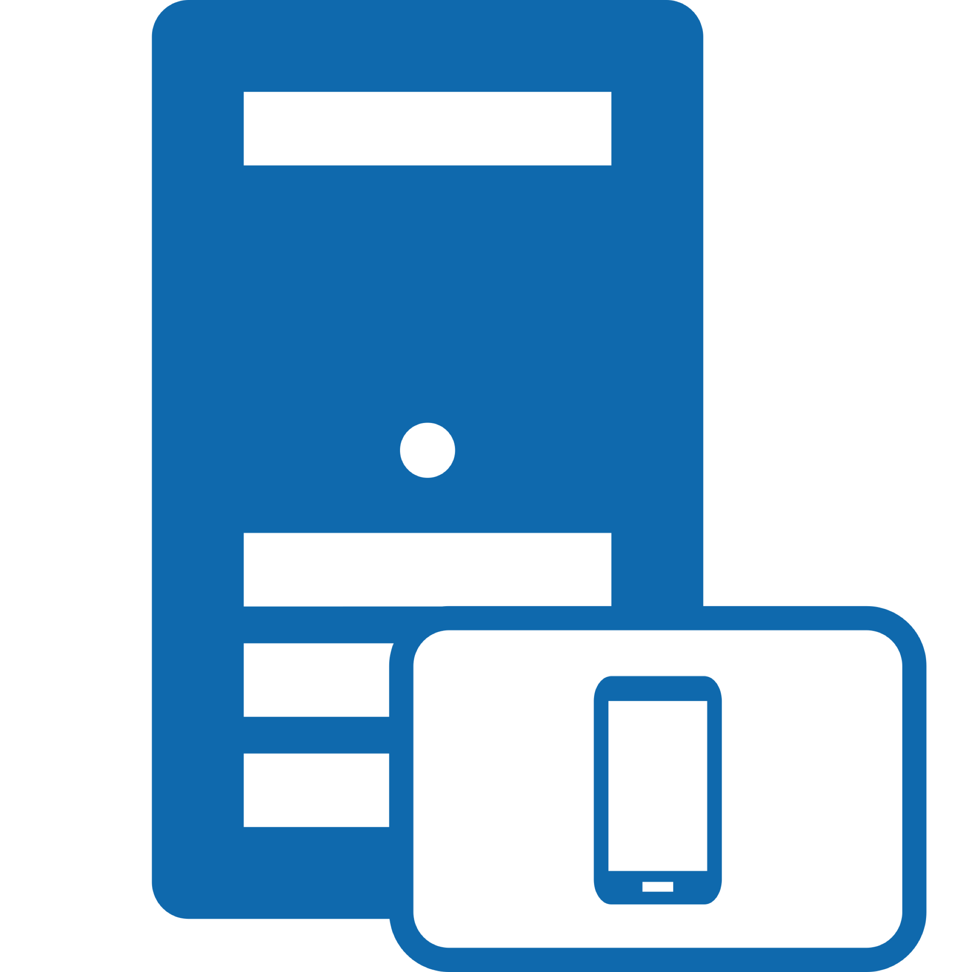
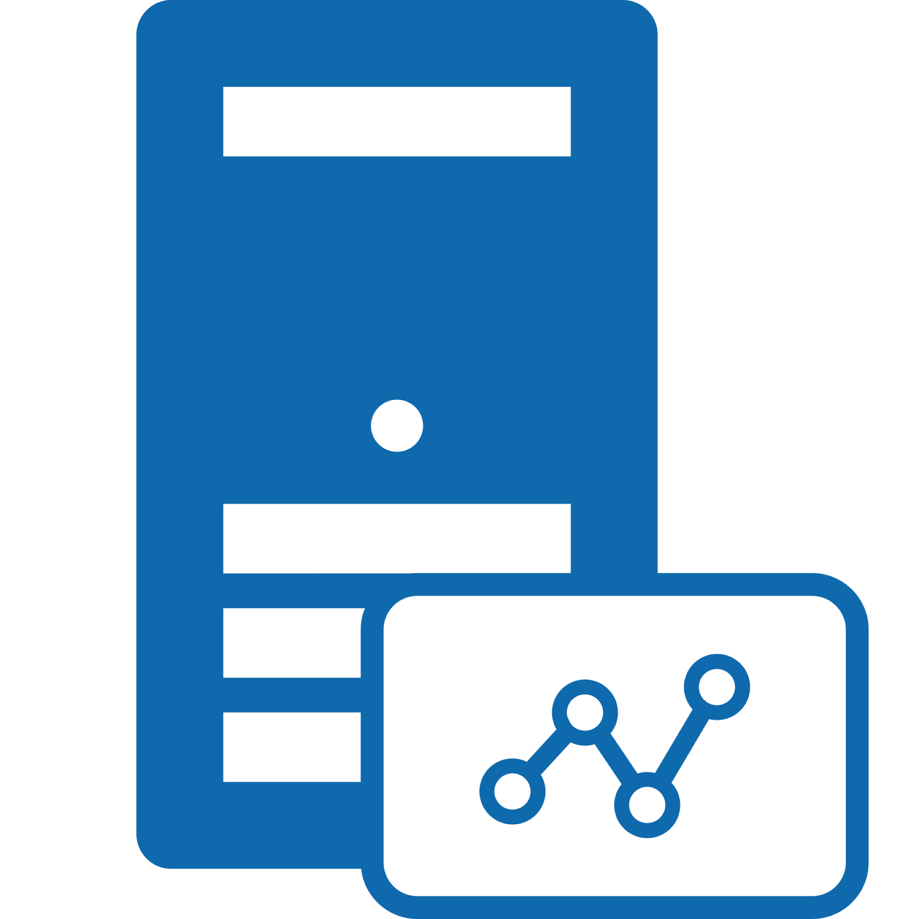
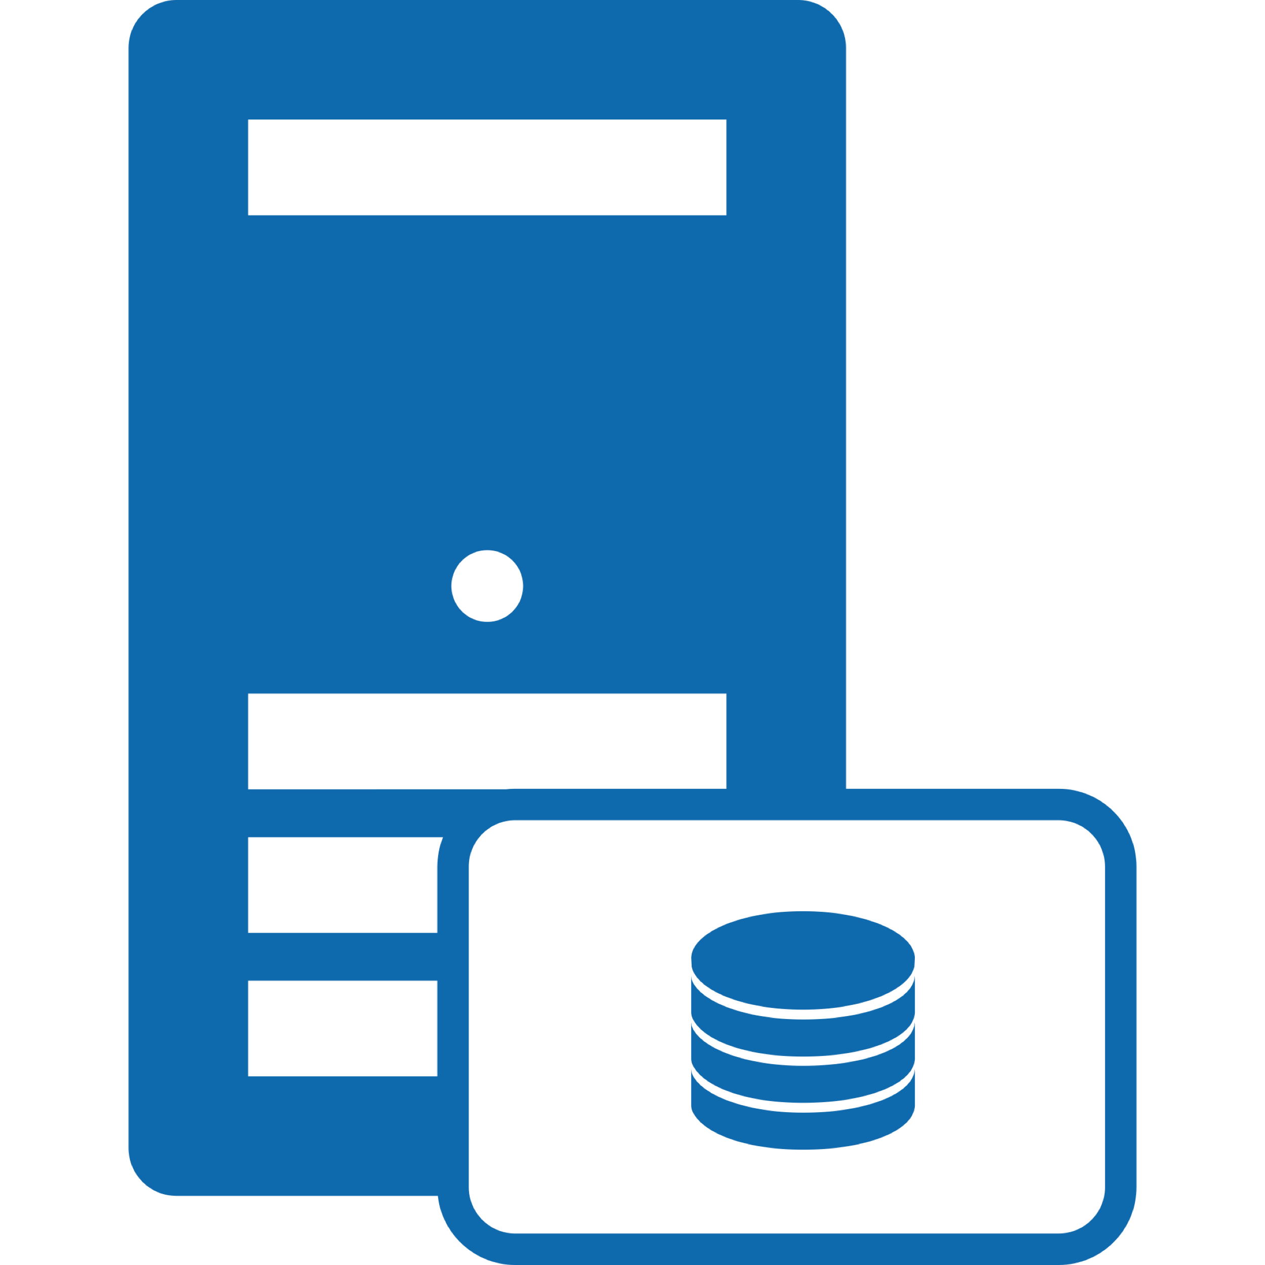
ONE TOOL FOR ALL PROTECTION SCENARIOS
Single Server
Application Farm
Core Applications
Remote / DR Site
WANSmart™
Service-Level Protection
Application-Level Protection
Site-Level Protection
Key Benefits
Fast failover/failback
Application-Aware
Proactive & automated
Non disruptive install
Planned maintenance
Supports most apps
Supports DAS or SAN
P2P, V2P & V2V
Key Benefits
Protects whole app
Business-Centric view
Reduces complexity
One tool for all servers
Centralized mgmt.
Centralized monitoring
Centralized Alerting
Key Benefits
Fast, user transparent failover for core applications
Flexible failover options, as full site recovery is not req.
Simple, push-button failback to production environment
Reduces WAN traffic by up to 30x & improves RPO/RTO
Provides low cost alternative to SRM & SAN replication
Supports any-storage-to-any storage
Supports physical, virtual & mixed environments
Supports VMware, Hyper-V & mixed environments
Notes:
Application Awareness:
- Fast and Predictable Application Aware Failover
Data Protection:
Near Zero Recovery Objectives (RPO/RTO)
Network Protection:
- WAN Optimization – Minimal Bandwidth
Site Protection:
- Failover Server, App Stack, or Entire Site
Ease of Deployment:
- No Manual Setup or Configuration
Vmware Integration:
- Extend your Investment to Application Layer

Slide 10
ENGINE BENEFITS
Application Awareness
Data Protection
Network Protection
Site Protection
Continuous Access to Application
Ease of Deployment
VMware Integration
Notes:
Application Awareness:
- Fast and Predictable Application Aware Failover
Data Protection:
Near Zero Recovery Objectives (RPO/RTO)
Network Protection:
- WAN Optimization – Minimal Bandwidth
Site Protection:
- Failover Server, App Stack, or Entire Site
Ease of Deployment:
- No Manual Setup or Configuration
Vmware Integration:
- Extend your Investment to Application Layer

Slide 11
Demonstration
Recorded Virtual to Virtual
Pair and Trio Development
Live Demonstration

Slide 12
Continuity Engine Pair
Automated Deployment

Slide 14
QUESTIONS?

Slide 15
RECOVERY TIERING APPROACH
Continuous Availability
High Availability Clustering Fault Tolerances
Backup and Recovery Technologies
Application Aware Fully Automated Recovery Orchestration
CDP Based Technologies and Hypervisor Replication
Basic Snapshots with CBT
Cloud Backup with Offsite Repository
Long Term Backups to Object Storage
Tier 0
Tier 1
Tier 2
Tier 3
Tier 4
Mission
Critical
Business
Critical
Business
Important
Data
Centric
Archival
RTO:
Seconds – A Few Minutes
RTO:
60 Minutes – 4 Hours
RTO:
4 – 12 Hours
RTO:
12 – 24 Hours
RTO:
24 +

Slide 16
COMPETITION
Competitor | Continuity Engine Advantages | Evolution Level
Double-Take Availability | Application Awareness, Tertiary, HA/DR in a Single Package, Deeply Integrated with VMWare | Data Driven
Zerto | Application Awareness, Tertiary, HA/DR in a Single Package, Physical Server Support, Protect Applications on Any Hypervisor Platform | Data Driven
Stratus EverRun | Deeply Integrated with VMWare, Physical Server Support, Protect Applications on ANY Hypervisor Platform not just OpenStack | Hardware Driven
WSFC w/Always On Active/Passive (SQL Protection) | Application Awareness, Tertiary, HA/DR in a Single Package, Can Function of High Latency or Congested Networks, Deeply Integrated with VMWare, Protects Any Application on Windows, Less Complex, Cheaper | Hardware Driven
Always On Availability Groups (SQL Protection) | Seconds to Minutes RPO, Application Awareness, HA/DR in a Single Package, Can Function in High Latency or Congested Networks, Deeply Integrated with VMWare, Protects Any Application on Windows, Full Reseeding Not Required After Failover, Less Complex, Cheaper | Data and Hardware Driven
Oracle RAC and Datagaurd | Exponentially cheaper (100K to over a 1000K) than RAC and significantly cheaper (10sK to 100sK) for not much more functionality. Engine provides enterprise class protection for Oracle at SMB pricing (a few thousand per protected application server). | Data Driven

Slide 17
COMPETITION
Competitor | Continuity Engine Advantages | Evolution Level
ArcServe RHA | Faster RTO, Failover Logic is Straightforward, Automatic Application Detection for Major Windows Apps. | Data Driven
SRM | Seconds to Minutes RTO, Application Awareness (Without Another VMWare Application), Tertiary, HA/DR in a Single Package, Physical Server Support, Protect Applications on Any Hypervisor Platform | Data Driven
VMWare HA | Application Awareness (Without Another VMWare Application), Tertiary, HA/DR in a Single Package, Physical Server Support, Protect Applications on Any Hypervisor Platform, No Single Point of VM Failure * | Hardware Driven
VMWare FT | Server | Hardware Driven
Veeam Backup and Replication | Application Awareness, Tertiary, HA/DR in a Single Package,, Protect Applications on Any Hypervisor Platform | Data and Hardware Driven
VMWare HA and FT provide protection at the VM level. Therefore if there is a VM level corruption the replicated VM will recover with this corruption. To minimize the risk they must be used with SRM but SRM is not application aware.

Slide 18
DATA ROLLBACK MODULE
Recovery From Ransomware
Primary
Hardware Clones are Isolated
Secondary
Apps
Apps
Replication
3 Days Ago
Data is Replicated Realtime
Recovery Point 3
C:/DB
C:/DB
Data Snapshots are Recovery Points
Today
Rollback Snapshot Before Infection

